Slide 1

Fur Ever Search (Data-Driven Dog Breed Recommendation Platform)

Slide 2
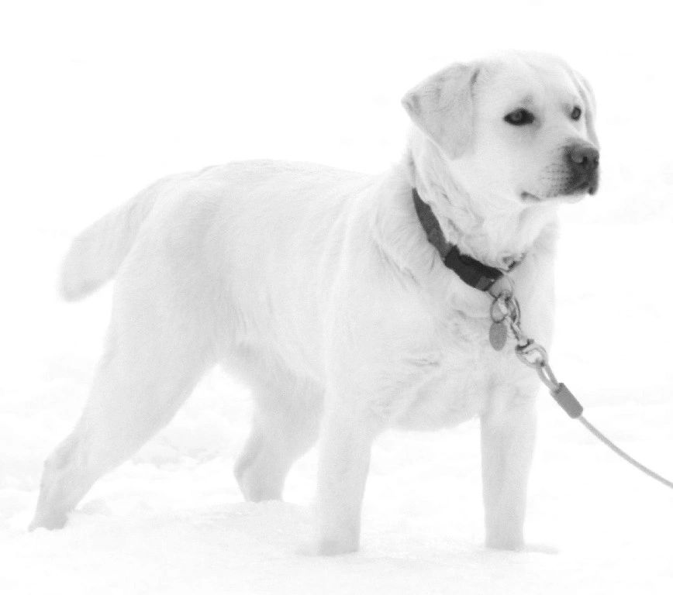
Objective
The aim is to design and implement a dog recommendation platform to provide users with personalized and relevant dog breed suggestions based on the user’s preferences, lifestyle, and specific requirements.
Introduction
The recommendation system is a combination of Data Science techniques and Web Application. The system will be trained on a dataset of dog breed information, such as size, energy level, and temperament. The system will be able to recommend dog breeds based on a set of trained machine-learning models.

Slide 3
Data Collection
Fur-Ever Search - Architecture
Recommendation System - Architecture
Web Source AKC
Flask
Processed Dataset
Flask
Collaborative Filtering
Get Data
Web Scrapper
Decision Trees
Clustering
Beautiful Soup
React.js
Get Recommendations
Random Forest
Beautiful Soup
SQL DB
Content based Filtering
Selenium Web Driver
Selenium Web driver
Web Application
Similarity Scores
DATABASE

Slide 4
Recommendation System Common Approaches
Collaborative filtering
user clusters
k nearest neighbors , DB-Scan , Hierarchical
Content based filtering
Item feature based similarities (movie genre, product category) etc.
Jaccard , Euclidean , Cosine
Common Problems
Cold Start

Slide 5
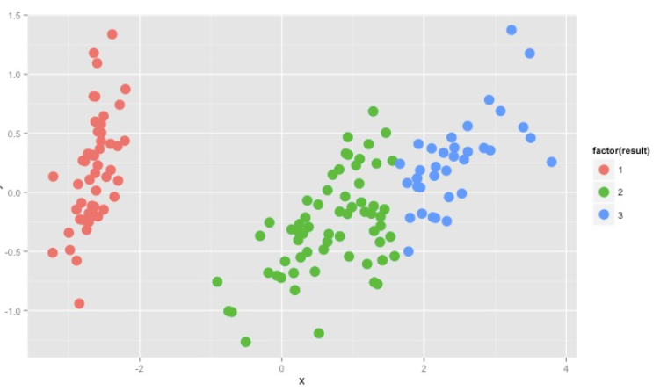

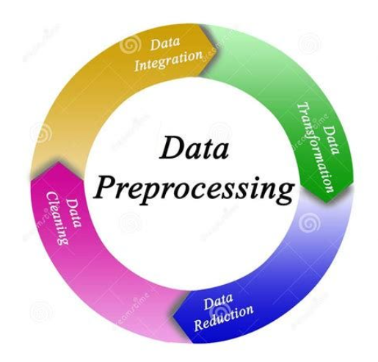


Recommendation System Architecture
Data preprocessing
User Clusters
Top 10 Dogs
Offline
Train Random forests
Load user data
Predict user cluster
Recommend top 10
Online
New User
Capture user interactions
Calculate Similar Dogs

Slide 6
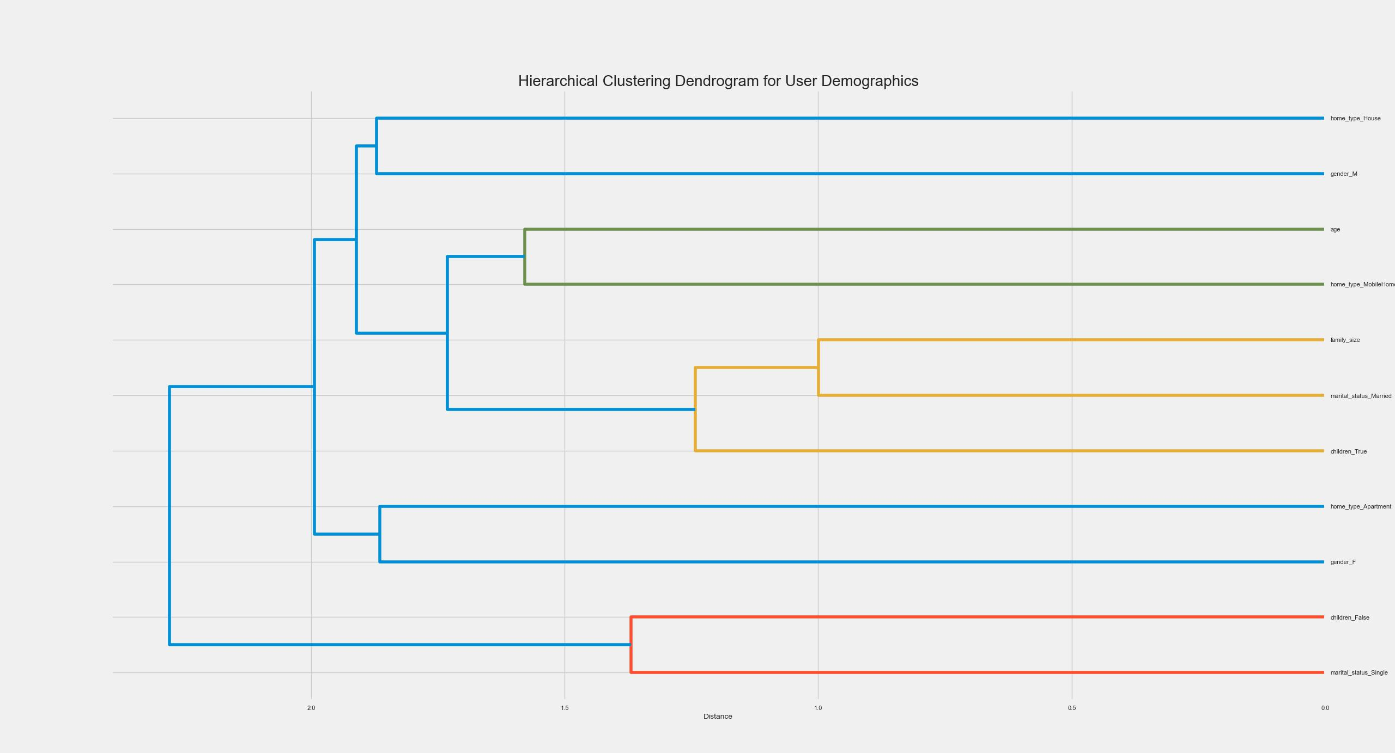
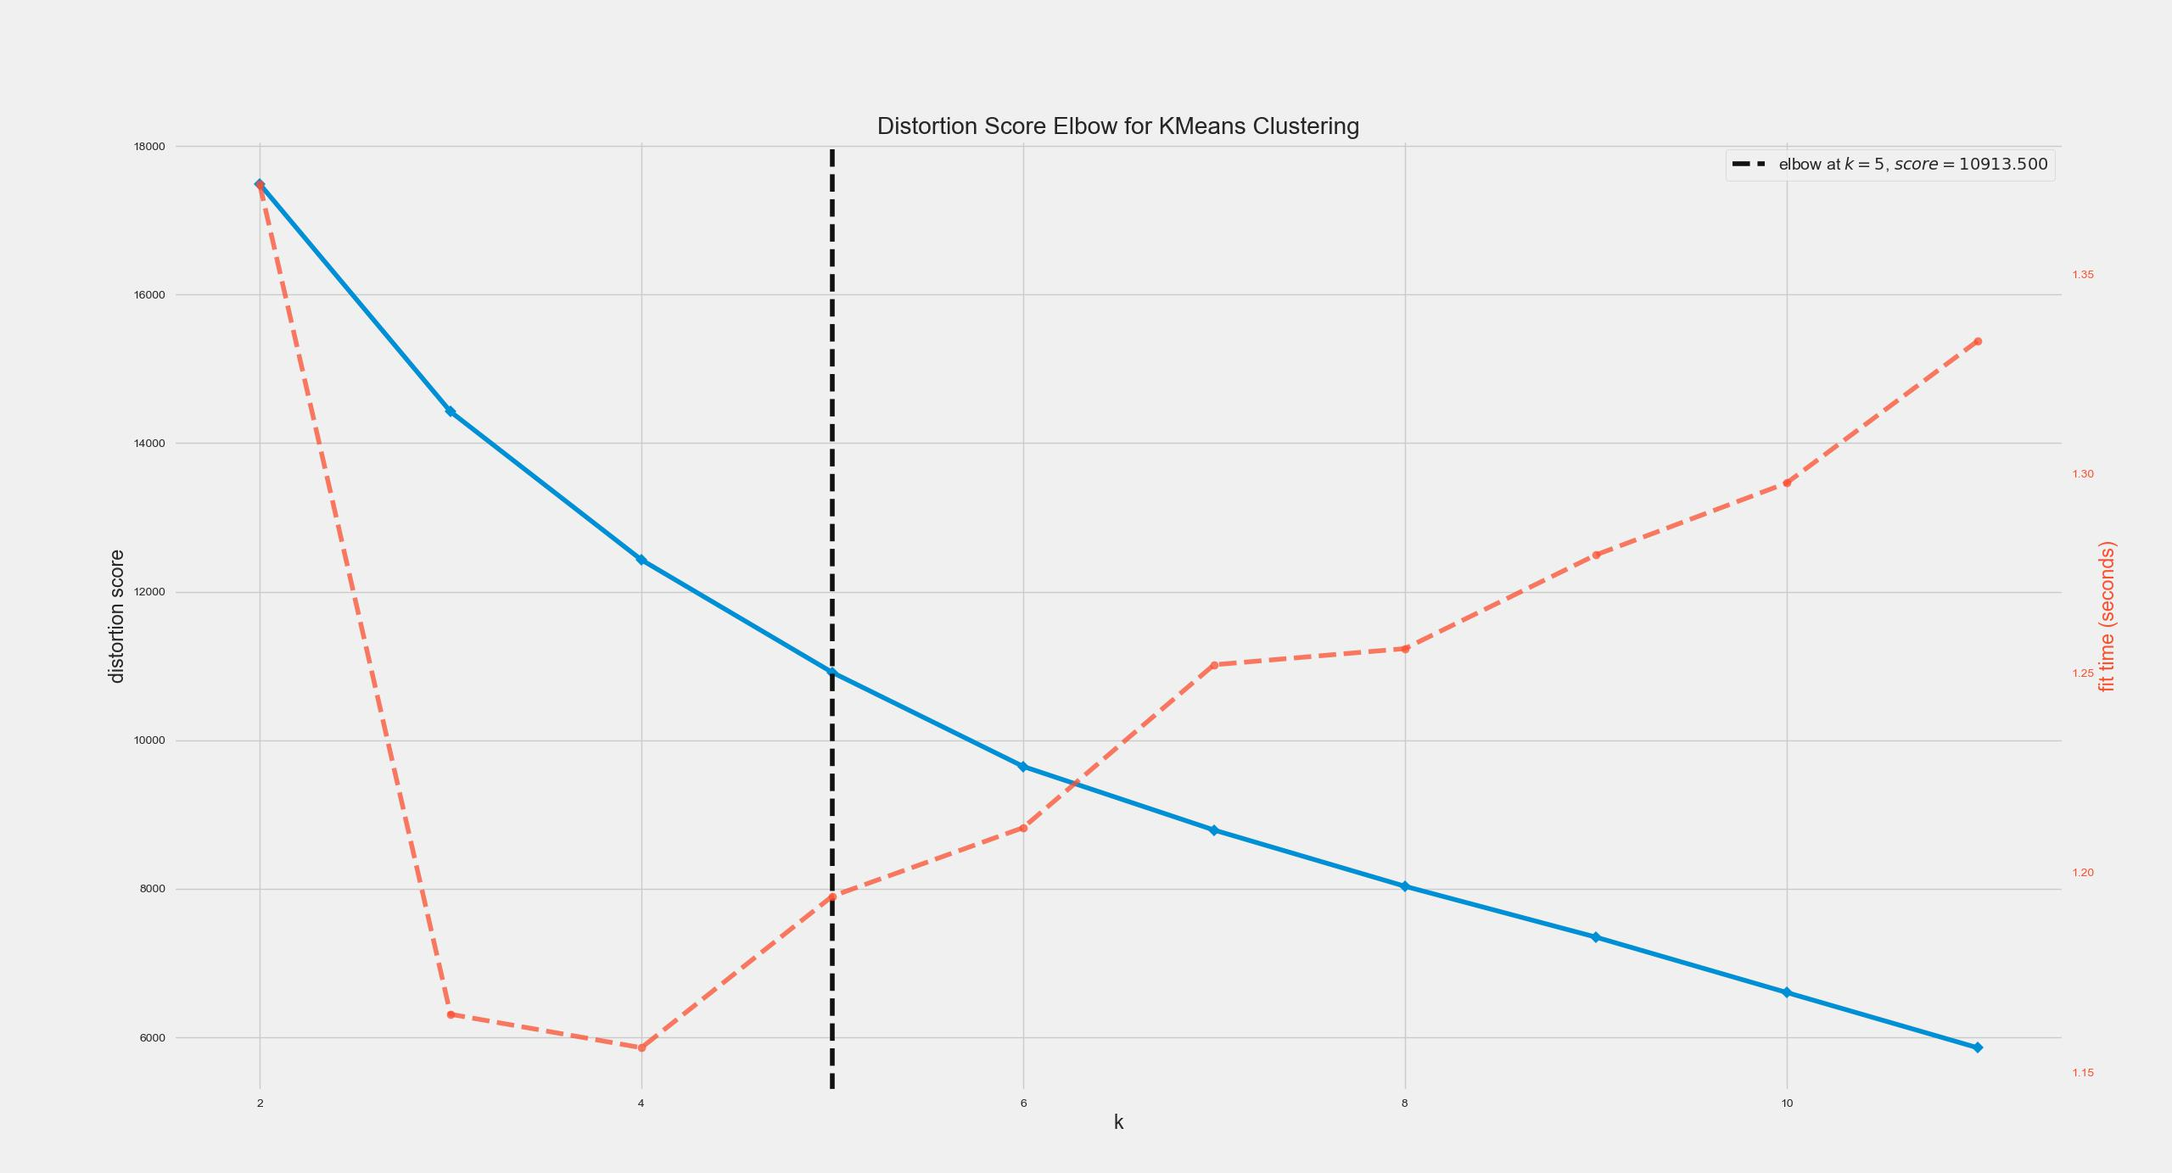
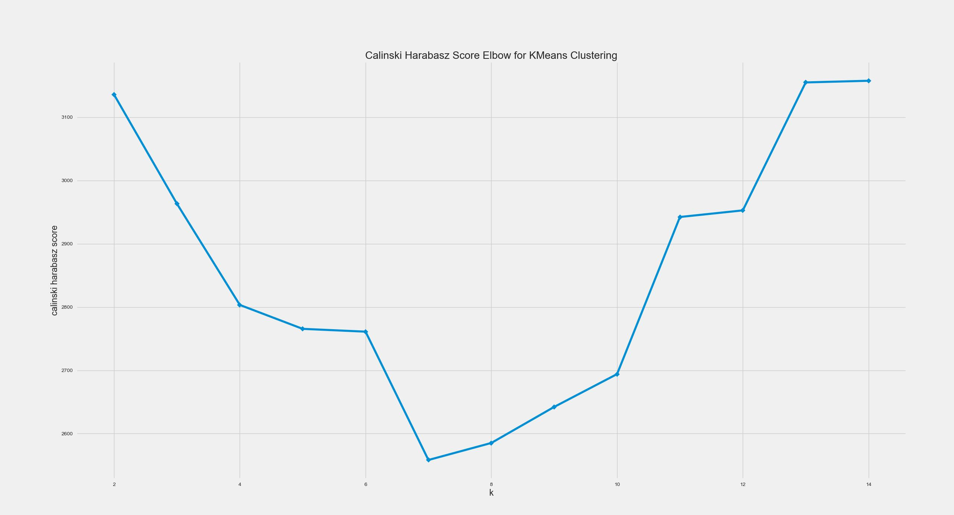
Offline – User Clusters
Hierarchical Cluster
Elbow Method
Calinski Harabasz

Slide 7
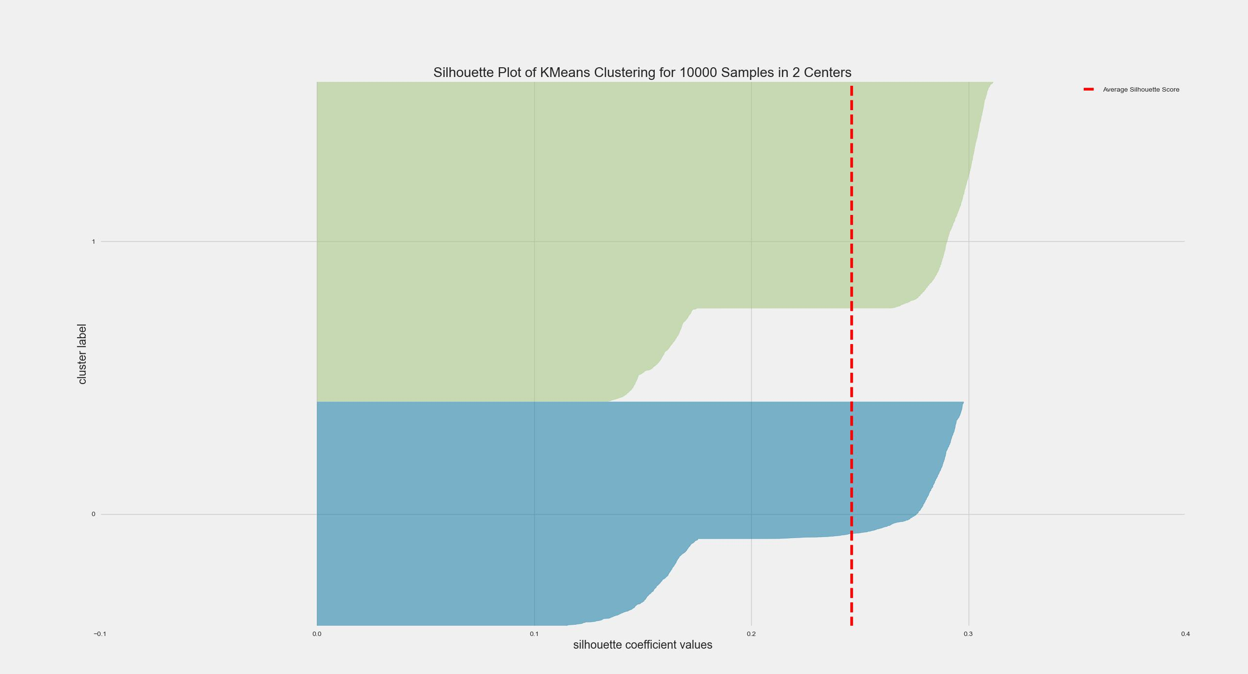
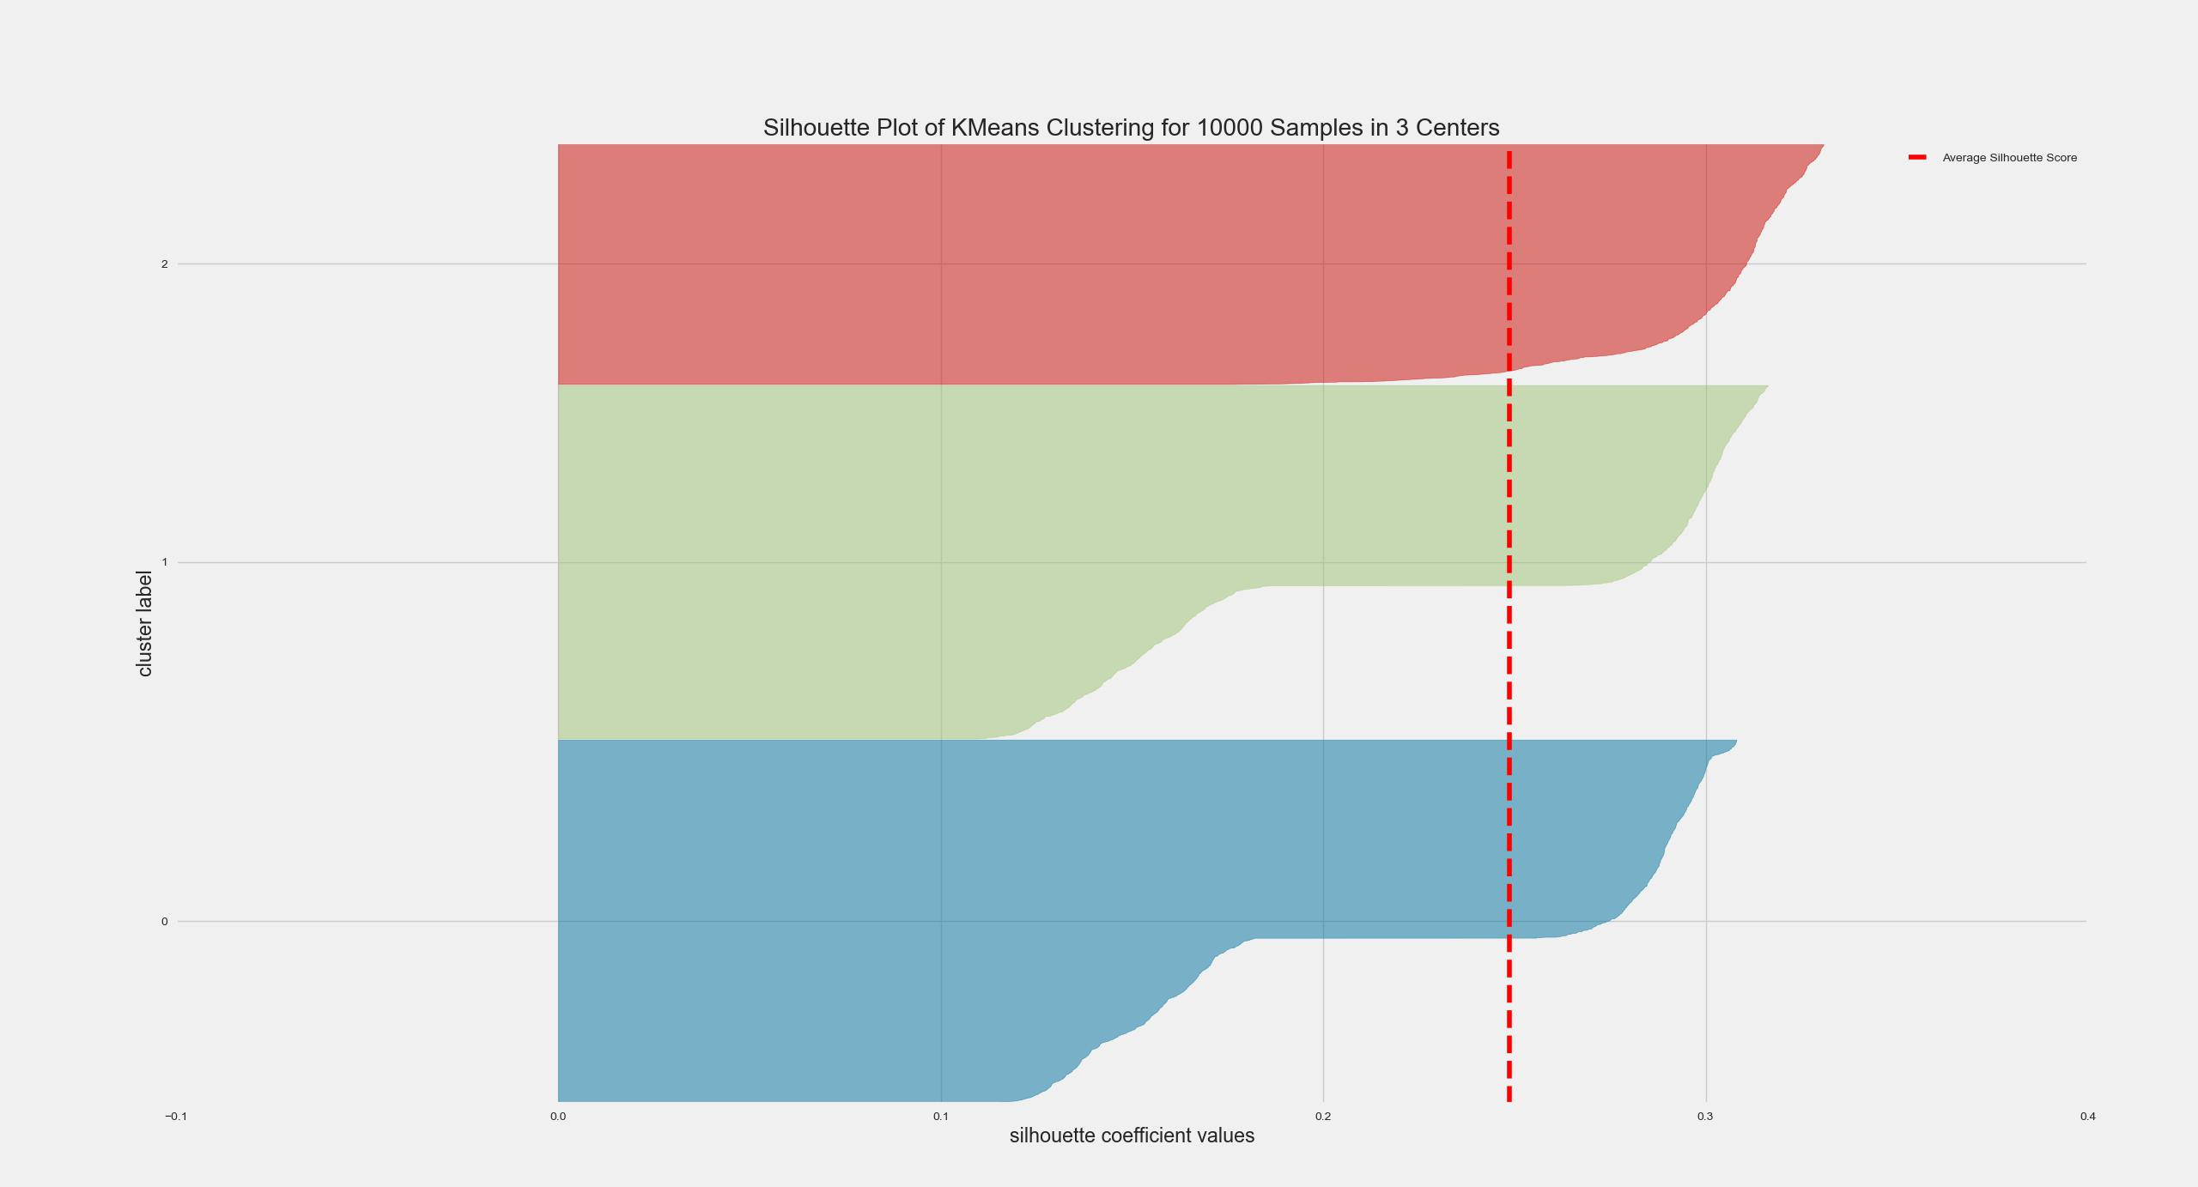
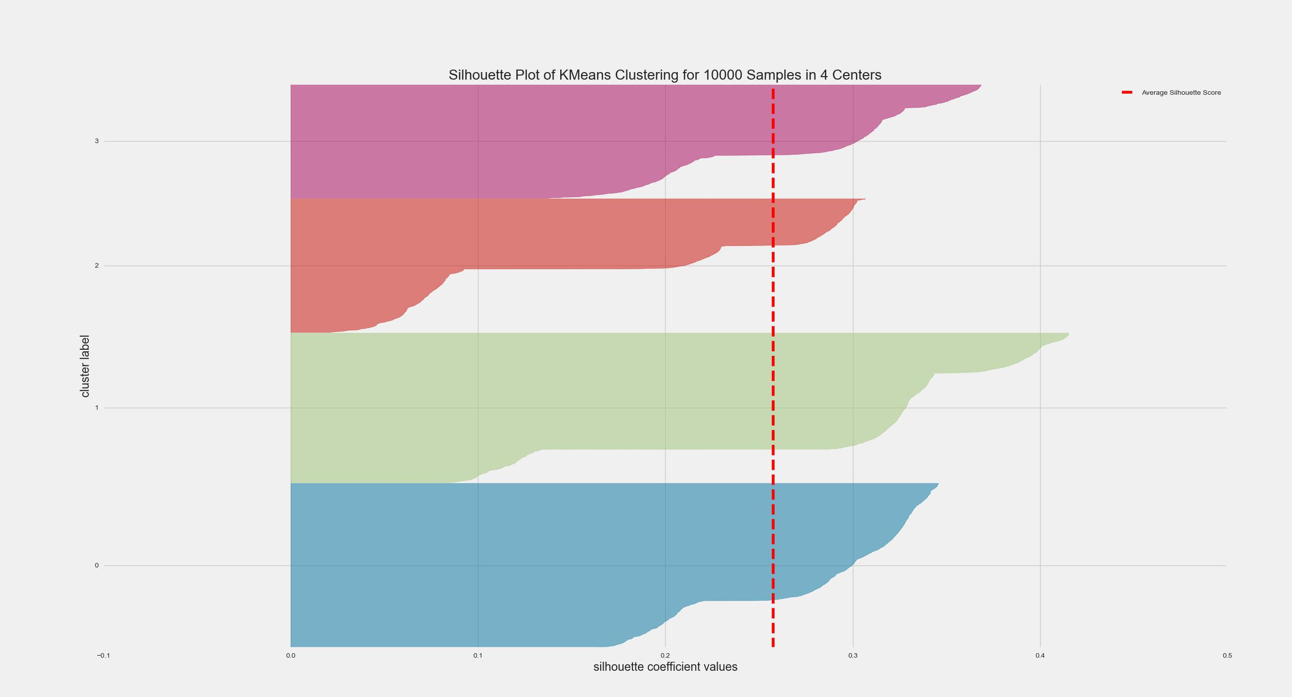
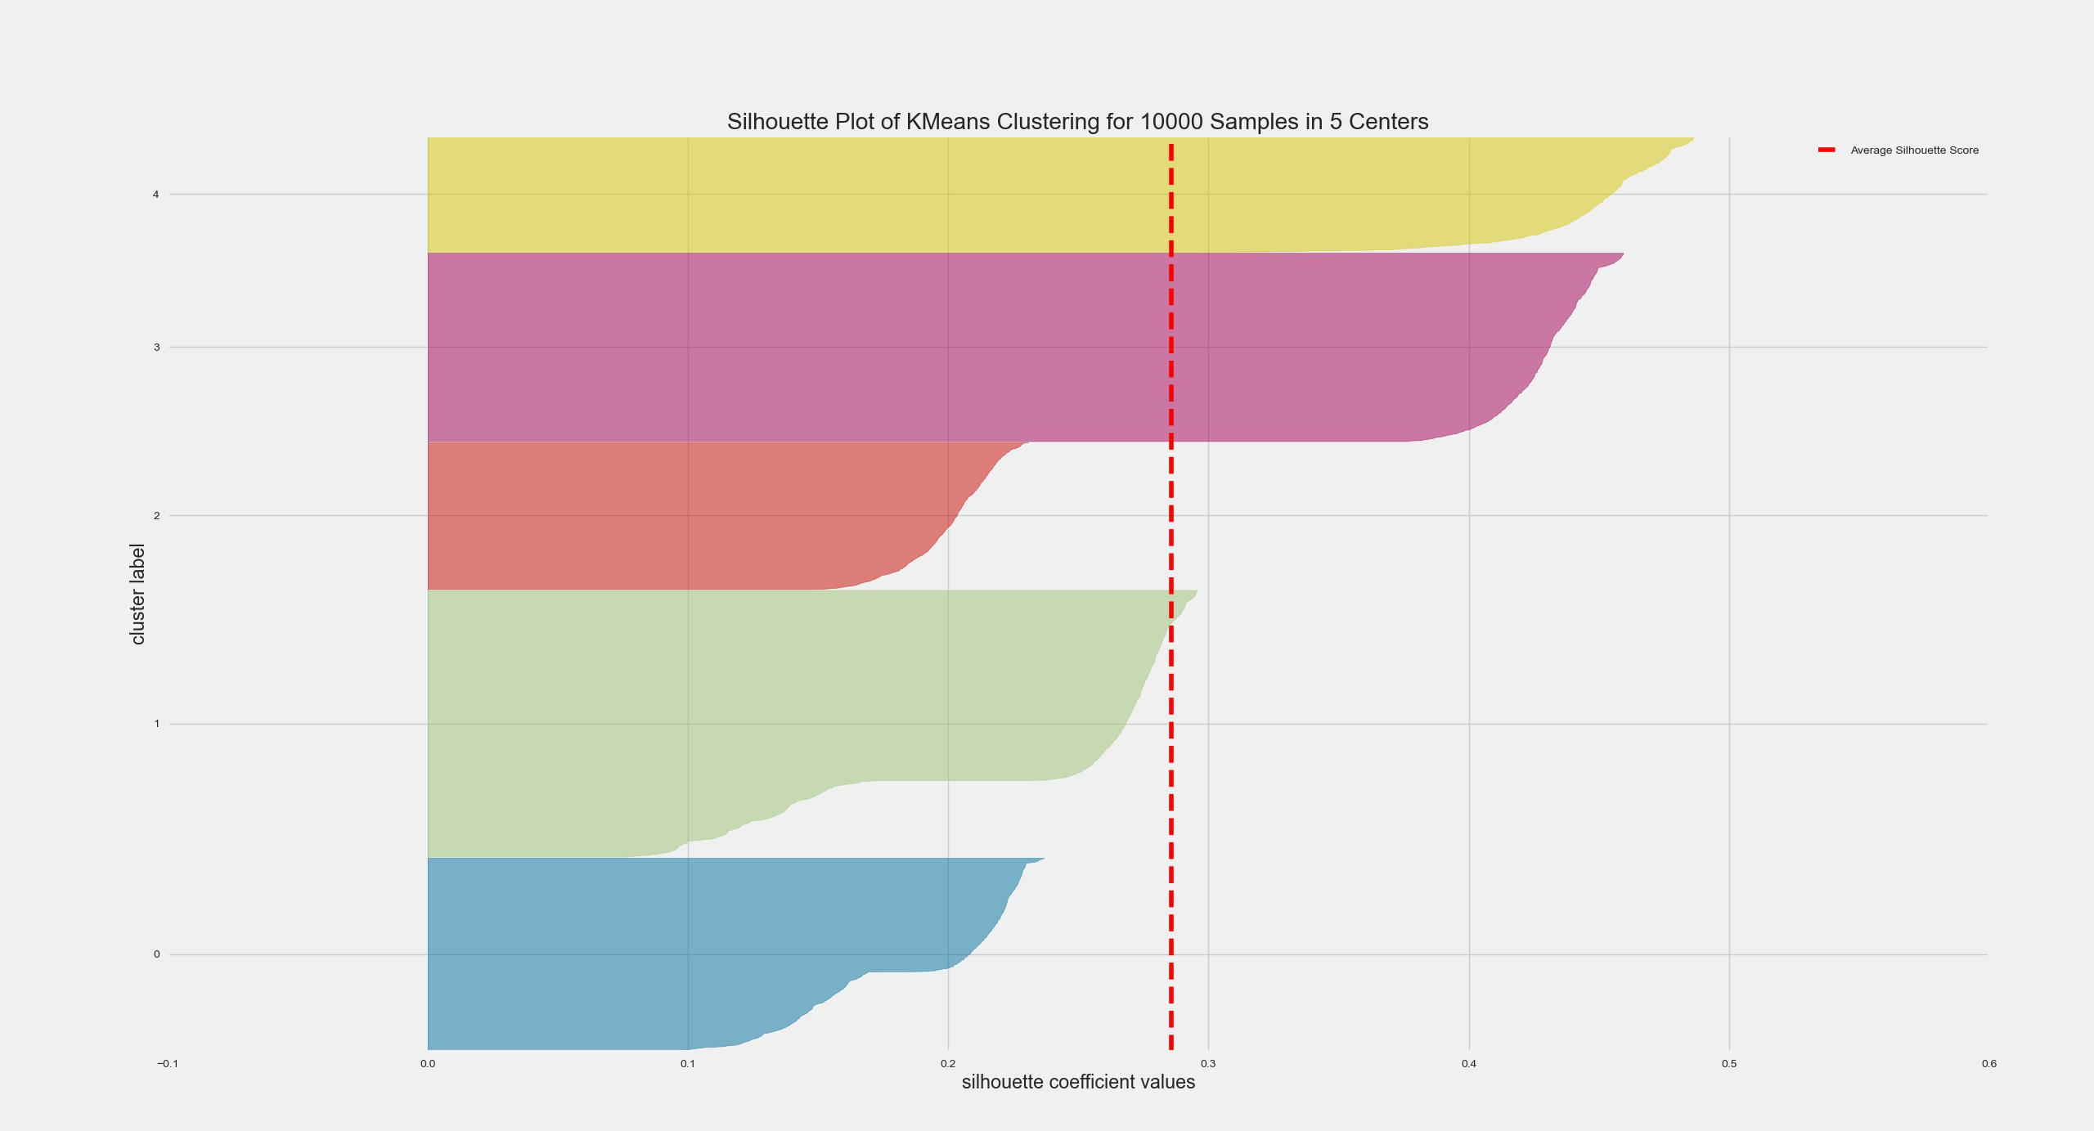
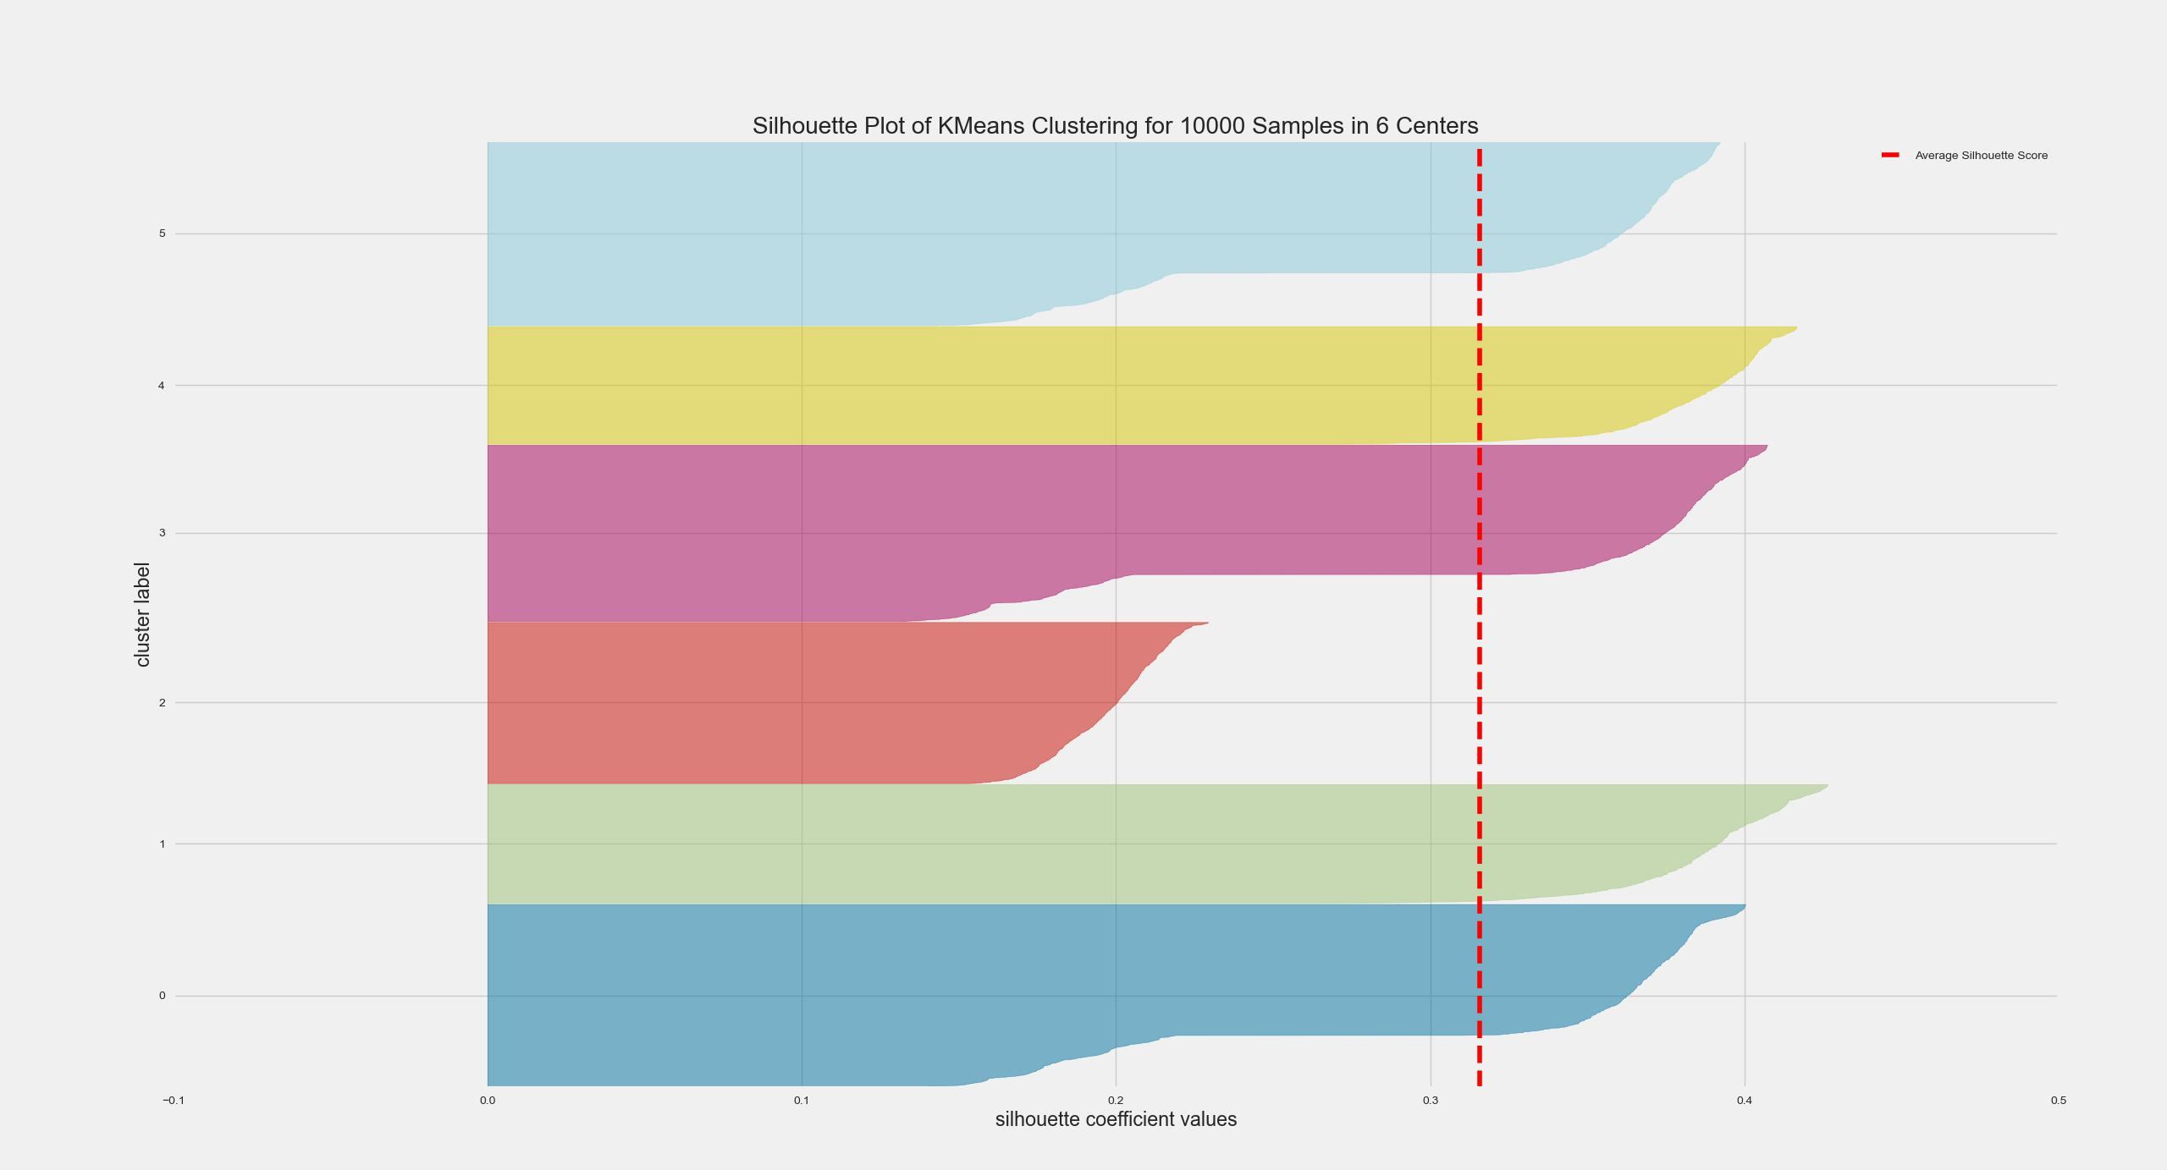
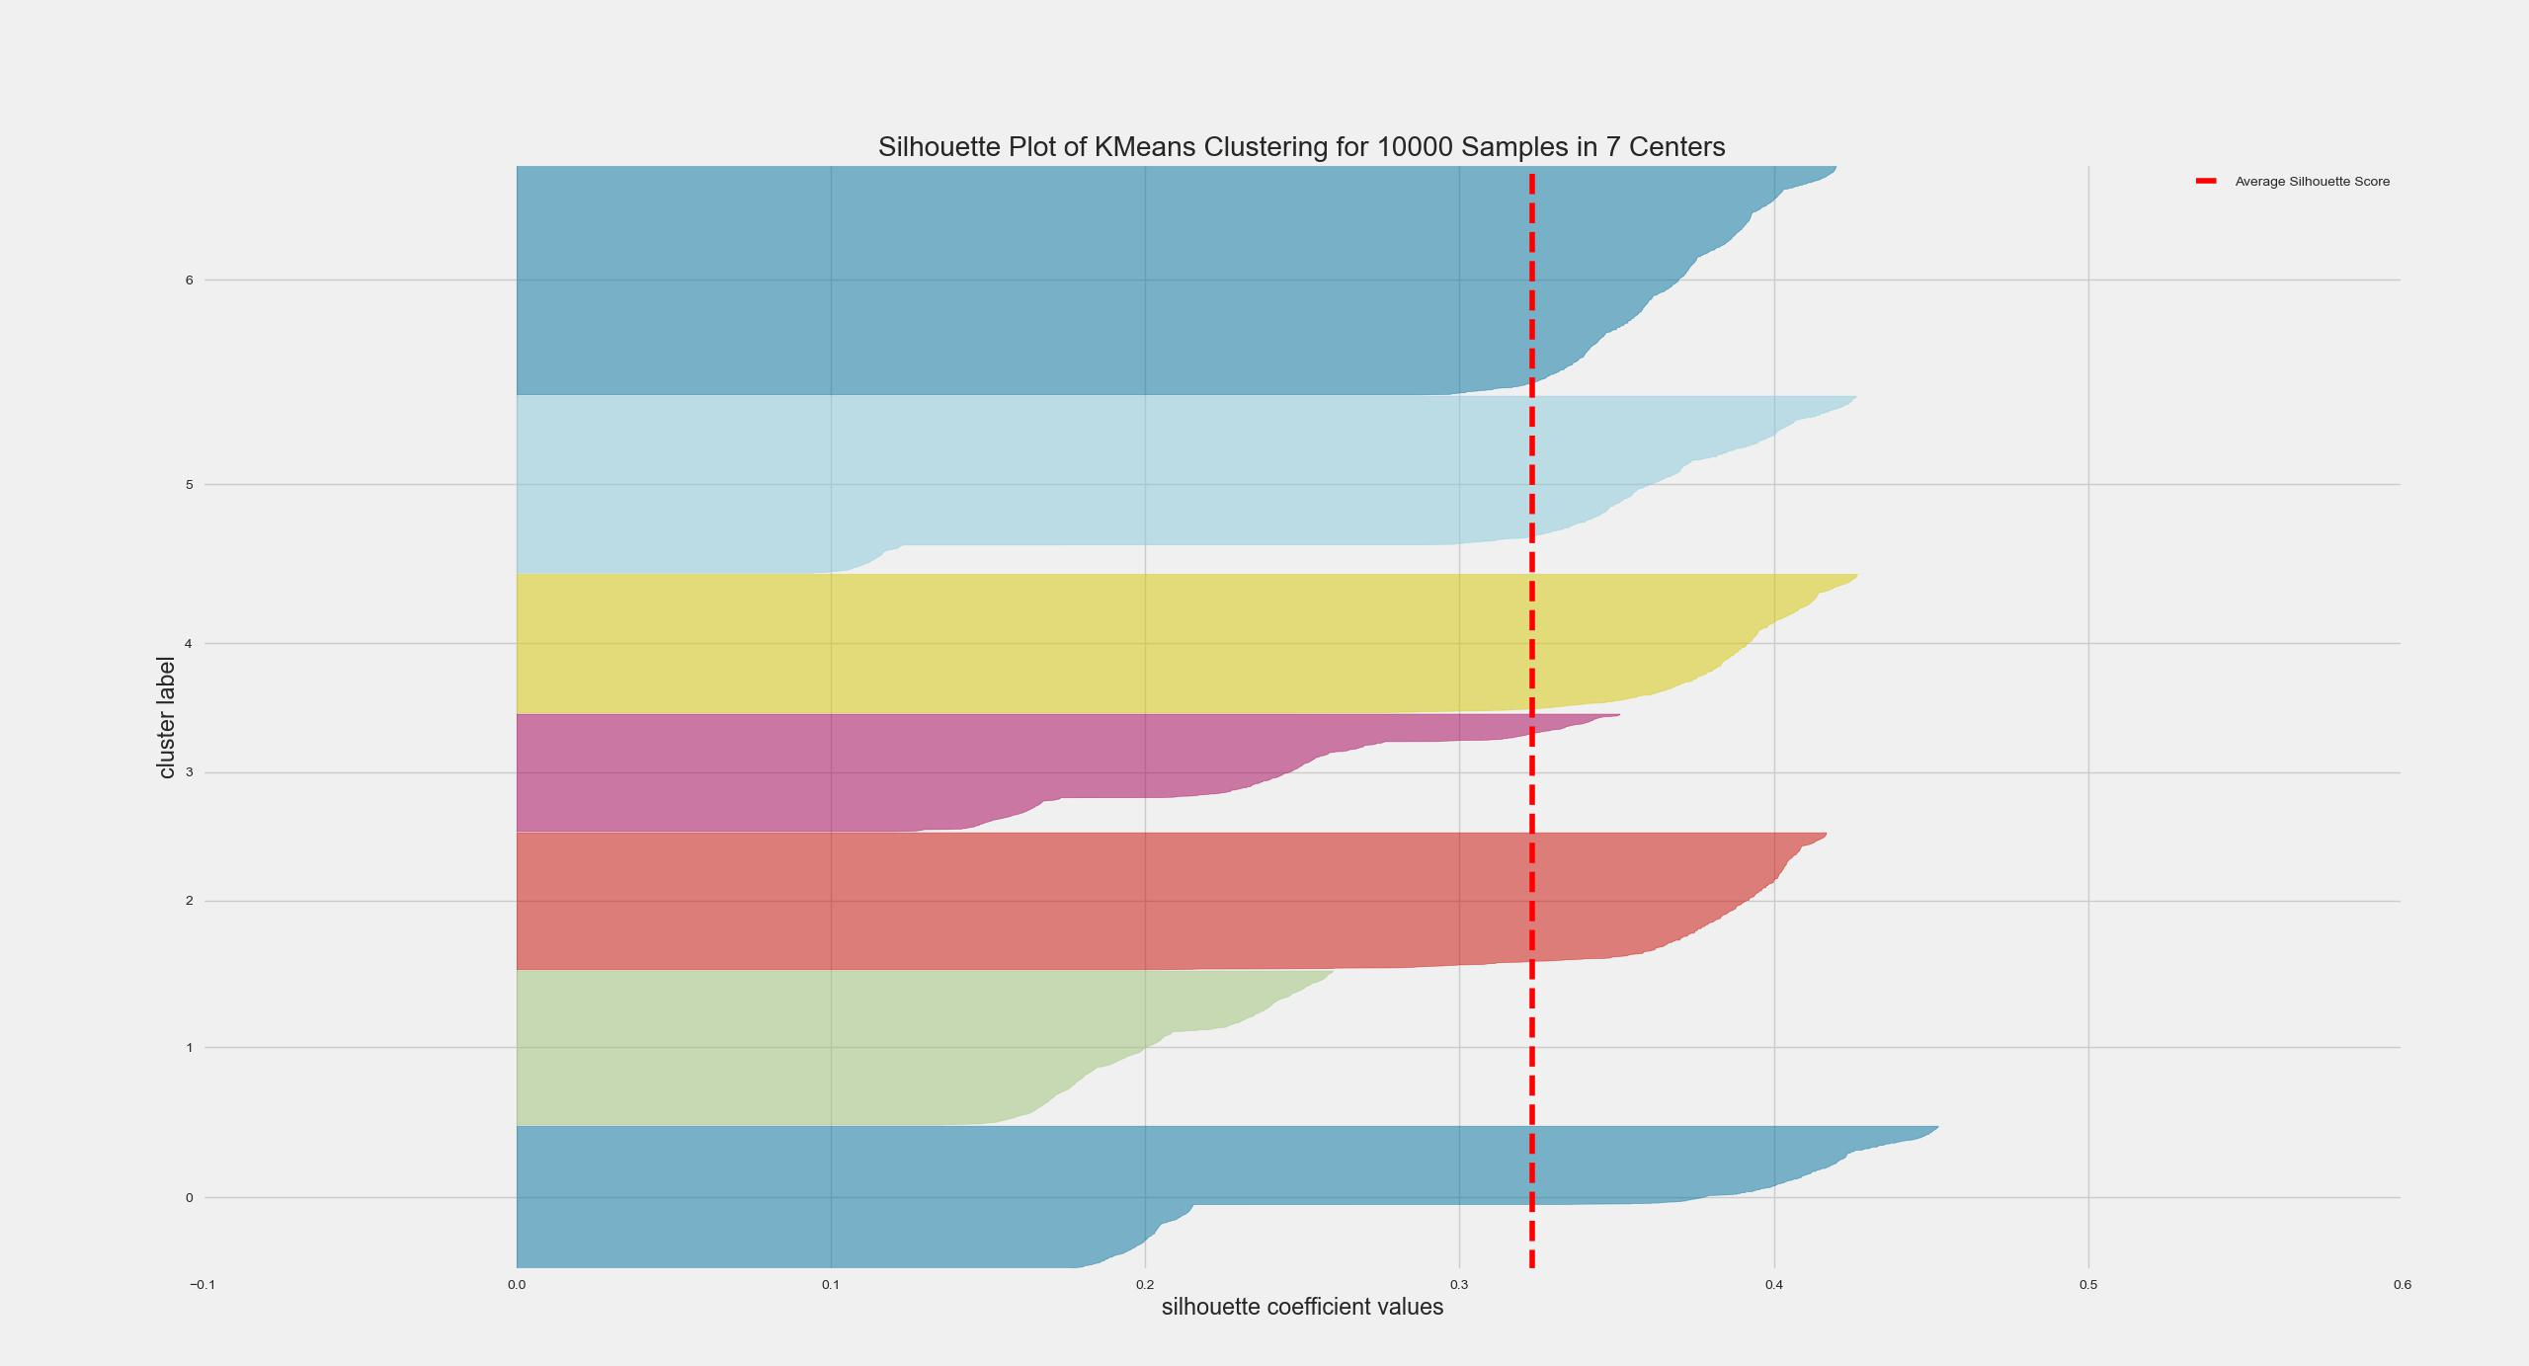
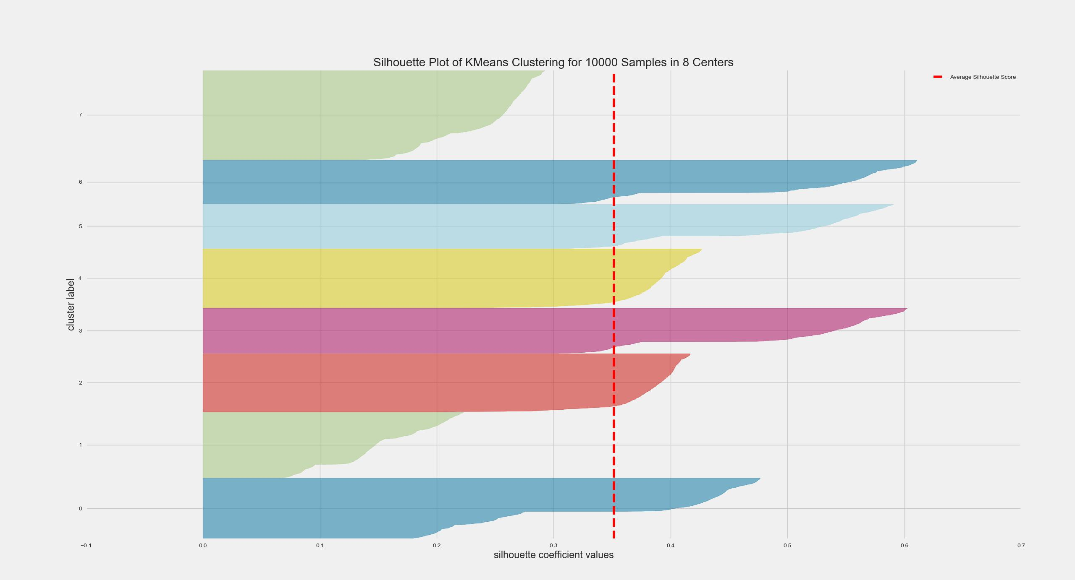
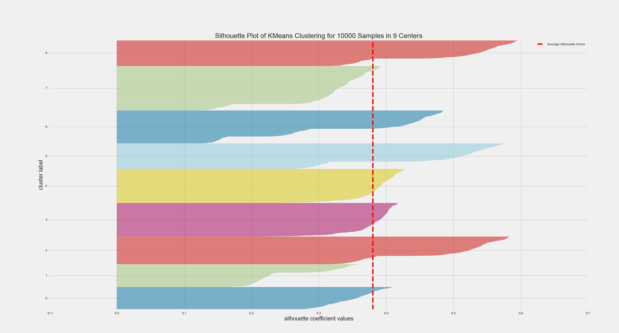
Silhouette Scores
K = 2
K = 3
K = 4
K = 5
K = 6
K = 7
K = 8
K = 9

Slide 8






User Interactions
Search (Home Page)
Breed Click (Home Page)
Explicit Feedback
Like
Search for Nearest Breed
YOUTUBE Interaction
Implicit
Explicit
Clicked on Dogs | 1
Manual Search | 2
Watched Video | 3
Searched for near by breeder/shelter | 4
Liked a Dog | 5

Slide 9
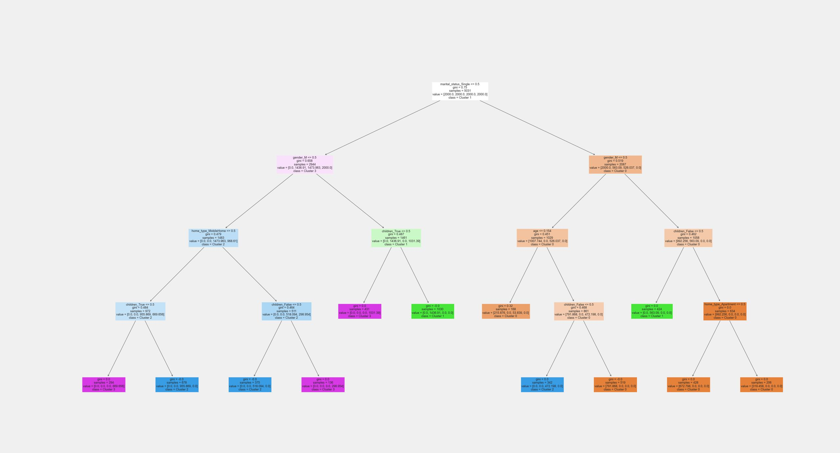
Decision Tree

Slide 10
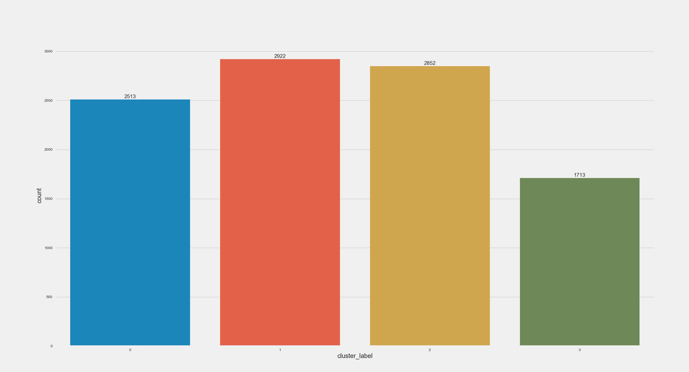
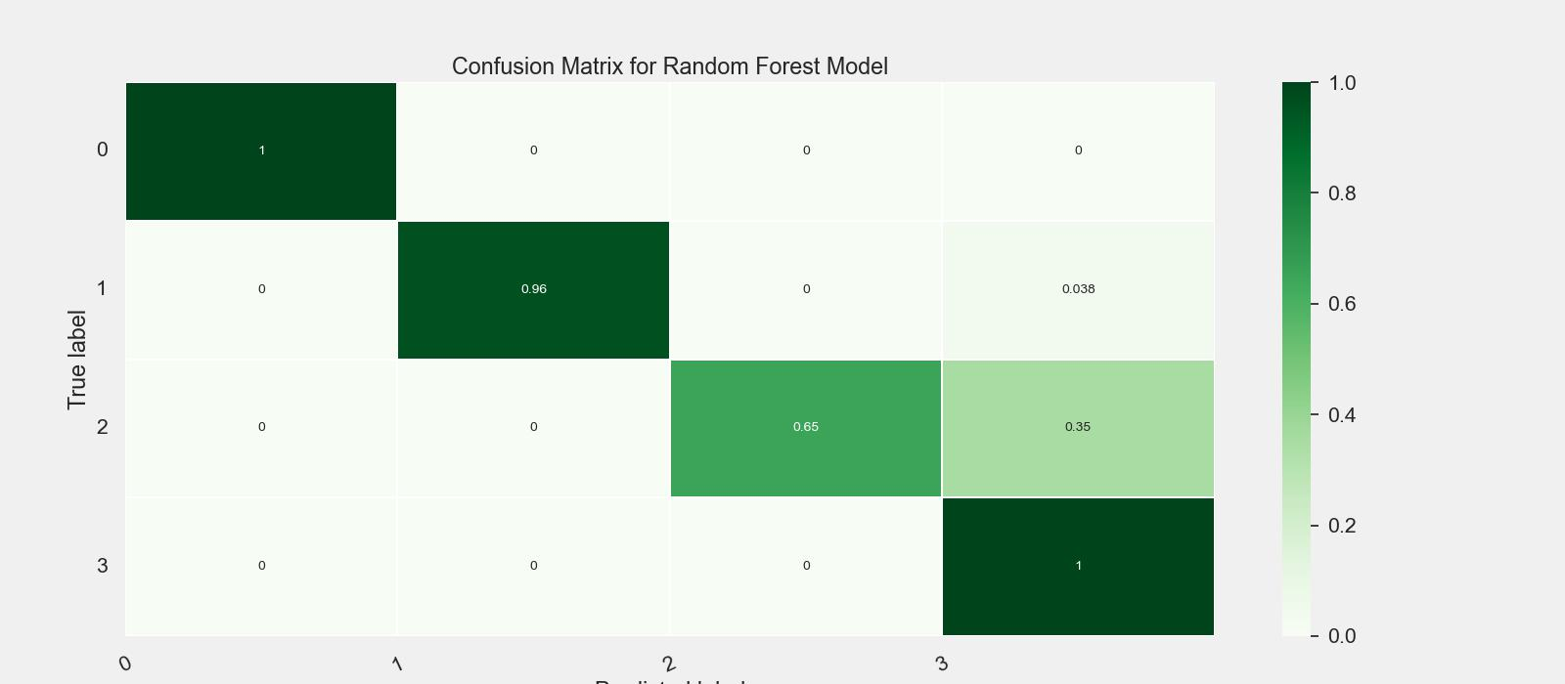
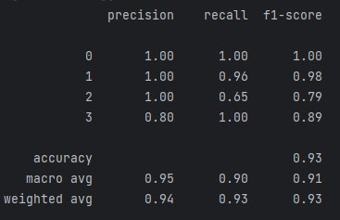
User Cluster
Heat map
Classification Report Accuracy – 92.79%

Slide 11
Online Process
Predict the cluster
Recommend top 10 dogs
Calculate similar dogs (cosine similarity)
Capture user interactions

Slide 12


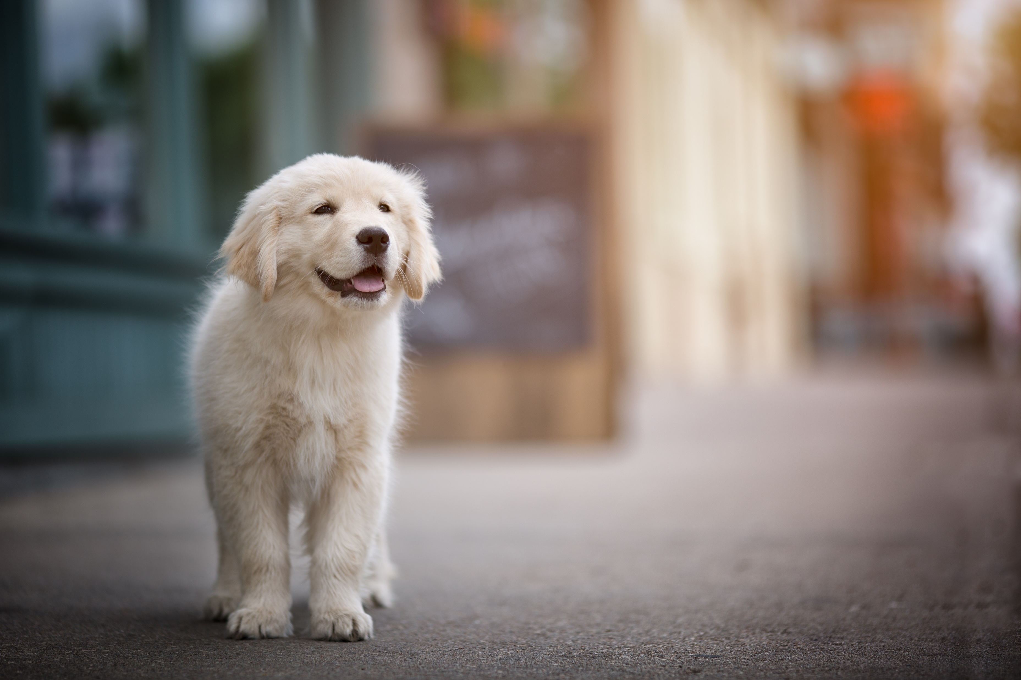
HOME PAGE
Breed Details
All available breeds
Breed bio, features, characteristics…. .
Specific Breed Search…
Selecting a breed from all available breeds list directs to…
Breed 1
Breed 2
Breed 3
Breed 4
Breed Name
Breed 5
Breed 6
Breed 7
Breed 8
Interesting facts of the Breed
Integrated YOUTUBE
Filtered Breeds based on search
Specific Breed Search…
Search for Nearest Breed Name
Selecting a breed from breed search list directs to…
AKC Breeder
Shelter
Breed 1
Breed 2
Breed 3
Breed 4
Recommended Breeds for selected Breed
Breed 7
Breed 8
Select Preferences
Breed 5
Breed 6
Breed 1
Breed 2
Breed 3
Breed 4

Slide 13












HOME PAGE
Breed Details
User Specific Breeds
Specific Breed Search…
Selecting a specific breed from the user specific breeds list directs to…
Breed bio, features, characteristics…. .
Breed 1
Breed 2
Breed 3
Breed 4
Breed 5
Breed 6
Breed 7
Breed 8
Breed Name
Recommendations Based on user data provided
Interesting facts of the Breed
User Info Page
Integrated YOUTUBE
Username
Name of the user
Search for Nearest Breed Name
Marital Status
Single
married
AKC Breeder
Shelter
Family Size
Recommended Breeds for selected Breed
Home Type
Mobile Home
Select Preferences
Age Group
Below 18
18+
30+
45+
60+
Breed 1
Breed 2
Breed 3
Breed 4
Children
YES
NO
NEXT

